Slide 1
Car Price Dashboard
By: Aparna C
Internship: Data Analyst Internship
Organization: Elevate Labs + MSME, Govt. of India

Slide 2
Objective
To design an interactive dashboard that helps business stakeholders
analyze trends in car selling prices using data visualization tools.

Slide 3
Dataset Information
Source: Kaggle
Dataset Name: Car Prices Dataset
Attributes:
- sellingprice, year, transmission, body type, odometer, state, etc.
Purpose: To explore factors affecting car prices and sales performance.

Slide 4
KPIs (Key Metrics)
1. Average Selling Price
2. Maximum Selling Price
3. Count of Cars Sold
4. Average Price by Body Type
5. Count of Transmission Type

Slide 5
Visualizations Used
Card visuals – Avg, Max, and Count of sellingprice
Bar chart – Average selling price by body type
Donut chart – Count by transmission
Line chart – Avg selling price over years
Scatter chart – Odometer vs selling price
Slicers – Year, Transmission, Body Type, State

Slide 6
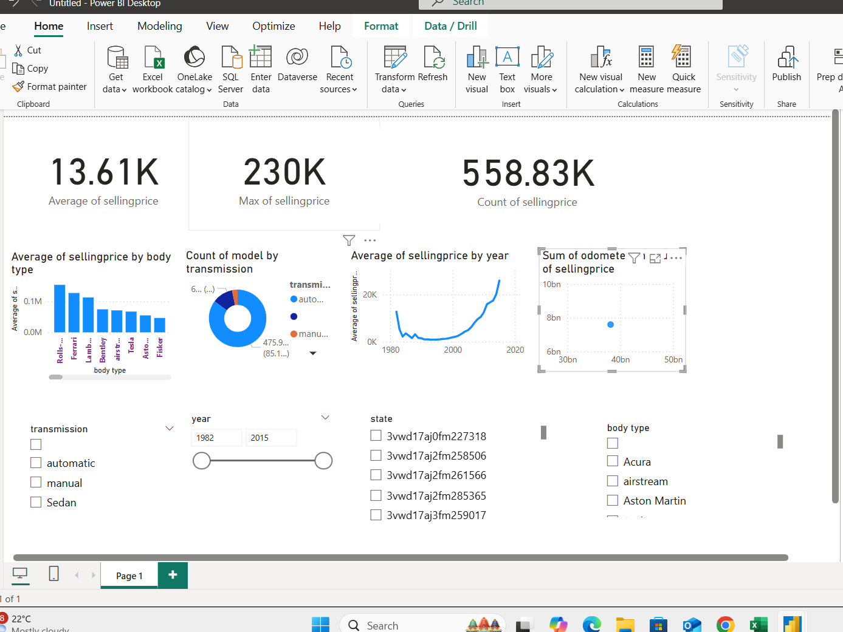

Slide 7
Key Insights
- Selling price has increased steadily after 2010.
- Automatic cars are more common than manual.
- Some body types (like SUVs and sedans) have higher average prices.
- Certain states or years show higher volumes of data.
These insights help understand market demand and pricing strategy.

Slide 8
Conclusion
The dashboard offers a quick and interactive way to explore
car pricing trends, helping stakeholders make data-driven decisions.
Tools Used: Microsoft Power BI
Skills Applied: Data Cleaning, KPI Selection, Visual Design, Interactivity

Slide 9
Thank You
For your time and consideration.
APARNA C
Data Analyst Intern

